Slide 1
ICTE 362 : Educational Software Development
Lesson 1

Slide 2
Introduction
Educational Software Development is a combination of Software Engineering, Software Development and Educational Technology.
Software Development is defined simply as the development of a software product.
Software Engineering is the application of a systematic, disciplined, quantifiable approach to the design, development, operation, and maintenance of software.
Educational technology is the study and ethical practice of facilitating learning and improving performance by creating, using and managing appropriate technological processes and resources.

Slide 3
Software
Software is both a product and a vehicle for delivering a product (information).
Software is engineered not manufactured.
Software does not wear out, but it does deteriorate.
Currently, most software is still custom-built.

Slide 4
Software Application Domains
System software—a collection of programs written to service other programs
Application software—stand-alone programs that solve a specific business need
Engineering/scientific software—has been characterized by “number crunching” algorithms.
Embedded software—resides within a product or system and is used to implement and control features and functions for the end user and for the system itself
Product-line software—designed to provide a specific capability for use by many different customers.

Slide 5
Software Application Domains
Web applications—called “WebApps,” this network-centric software category spans a wide array of applications. In their simplest form, WebApps can be little more than a set of linked hypertext files that present information using text and limited graphics
Artificial intelligence software—makes use of nonnumerical algorithms to solve complex problems that are not amenable to computation or straightforward analysis. Applications within this area include robotics, expert systems, pattern recognition (image and voice), artificial neural networks, theorem proving, and game playing

Slide 6
What is a Software Process?
A set of activities whose goal is the development or evolution of software.
Generic activities in all software processes are:
Specification - what the system should do and its development constraints
Development - production of the software system
Validation - checking that the software is what the customer wants
Evolution - changing the software in response to changing demands.

Slide 7
Software Process Models
A simplified representation of a software process, presented from a specific perspective.
Examples of process perspectives are
Workflow perspective - sequence of activities;
Data-flow perspective - information flow;
Role/action perspective - who does what.
Generic process models
Prescriptive – Waterfall
Iterative – Incremental, RAD
Evolutionary – Spiral, Prototyping

Slide 8
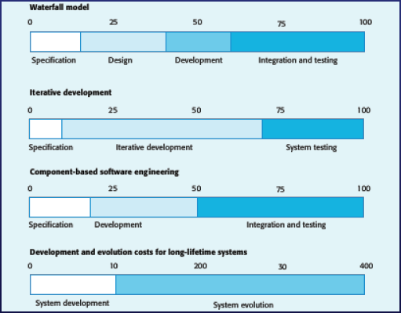
Activity Cost Distribution

Slide 9
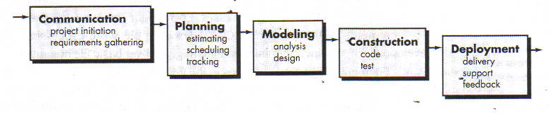
Prescriptive Process Model
Waterfall Model (old fashioned but reasonable approach when requirements are well understood)

Slide 10
Waterfall Model Problems
1. Real projects rarely follow the sequential flow that the model proposes. Although the Waterfall model can accommodate iteration, it does so indirectly. As a result, changes can cause confusion as the project team proceeds.
2. It is often difficult for the customer to state all requirements explicitly. The linear sequential model requires this and has difficulty accommodating the natural uncertainty that exists at the beginning of many projects.
3. The customer must have patience. A working version of the program(s) will not be available until late in the project time-span. A major blunder, if undetected until the working program is reviewed, can be disastrous.

Slide 11
Iterative Process Models
Incremental Model delivers software in small but usable pieces, each piece builds on pieces already delivered
Rapid Application Development (RAD) Model makes heavy use of reusable software components with an extremely short development cycle

Slide 12
Incremental Model
The incremental model combines elements of the linear sequential model (applied repetitively) with the iterative philosophy of prototyping:
The incremental model applies linear sequences in a staggered fashion as calendar time progresses.
Each linear sequence produces a deliverable “increment” of the software

Slide 13
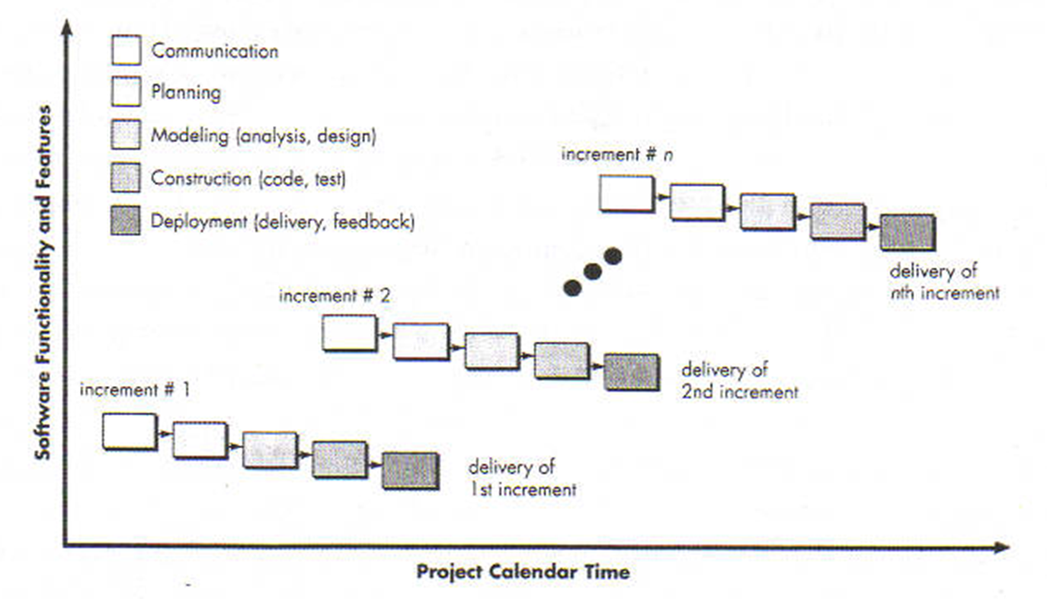
Incremental Model

Slide 14
Rapid Application Development
(RAD) is an incremental software development process model that emphasizes an extremely short development cycle.
The RAD model is a “high-speed” adaptation of the linear sequential model in which rapid development is achieved by using component-based construction.
If requirements are well understood and project scope is constrained, the RAD process enables a development team to create a “fully functional system” within very short time periods (e.g., 60 to 90 days)

Slide 15
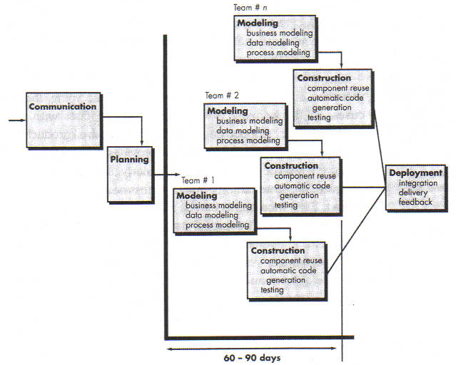
Rapid Application Development

Slide 16
RAD Model Problems
For large but scalable projects, RAD requires sufficient human resources to create the right number of RAD teams.
RAD requires developers and customers who are committed to the rapid-fire activities. If commitment is lacking from either constituency, RAD projects will fail.
Not all types of applications are appropriate for RAD. If a system cannot be properly modularized, building the components necessary for RAD will be problematic. If high performance is an issue and performance is to be achieved through tuning the interfaces to system components, the RAD approach may not work.
RAD is not appropriate when technical risks are high. This occurs when a new application makes heavy use of new technology or when the new software requires a high degree of interoperability with existing computer programs.

Slide 17
Evolutionary Process Models
Prototyping Model is a good first step when customer has a legitimate need, but is clueless about the details; the developer needs to resist pressure to extend a rough prototype into a production product)
Spiral Model couples iterative nature of prototyping with the controlled and systematic aspects of the linear sequential model
These models are preferred if the developer is unsure of the efficiency of an algorithm, the adaptability of an operating system, or the form that human/machine interaction should take.

Slide 18
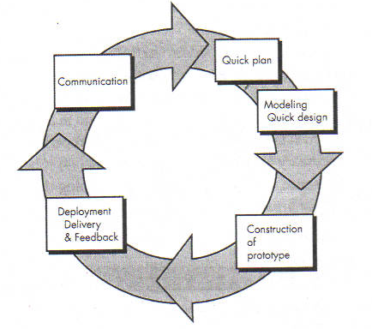
Prototyping Model
Although problems can occur, prototyping can be an effective paradigm for software engineering.
The key is to define the rules of the game at the beginning; that is, the customer and developer must both agree that the prototype is built to serve as a mechanism for defining requirements.
It is then discarded (at least in part) and the actual software is engineered with an eye toward quality and maintainability.

Slide 19
Prototyping Model Problems
The customer sees what appears to be a working version of the software, unaware that the prototype is held together “with chewing gum and baling wire,” unaware that in the rush to get it working no one has considered overall software quality or long-term maintainability.
The developer often makes implementation compromises in order to get a prototype working quickly. An inappropriate operating system or programming language may be used simply because it is available and known; an inefficient algorithm may be implemented simply to demonstrate capability.

Slide 20
Spiral Model
Spiral Model is an evolutionary software process model that couples the iterative nature of prototyping with the controlled and systematic aspects of the linear sequential model.
It provides the potential for rapid development of incremental versions of the software.
Using the spiral model, software is developed in a series of incremental releases.
During early iterations, the incremental release might be a paper model or prototype.
During later iterations, increasingly more complete versions of the engineered system are produced.

Slide 21
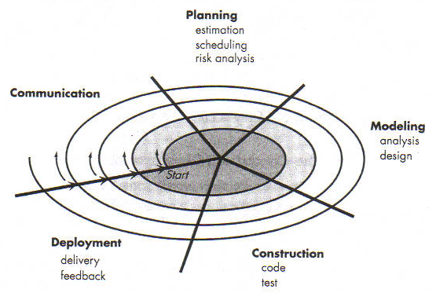
Spiral Model

Slide 22
Spiral Model Problems
Like other paradigms, the spiral model is not a panacea. It may be difficult to convince customers (particularly in contract situations) that the evolutionary approach is controllable.
It demands considerable risk assessment expertise and relies on this expertise for success. If a major risk is not uncovered and managed, problems will undoubtedly occur.
Finally, the model has not been used as widely as the linear sequential or prototyping paradigms. It will take a number of years before efficacy of this important paradigm can be determined with absolute certainty

Slide 23
Attributes of Software
The software should deliver the required functionality and performance to the user and should be maintainable, dependable and acceptable.
Maintainability
Software must evolve to meet changing needs;
Dependability
Software must be trustworthy;
Efficiency
Software should not make wasteful use of system resources;
Acceptability
Software must be accepted by the users for which it was designed.
This means it must be understandable, usable and compatible with other systems.

Slide 24
Software Engineering Challenges
Heterogeneity, delivery and trust.
Heterogeneity
Developing techniques for building software that can cope with heterogeneous platforms and execution environments;
Delivery
Developing techniques that lead to faster delivery of software;
Trust
Developing techniques that demonstrate that software can be trusted by its users.

Slide 25
Assignment 1
Select an educational software project and identify the most appropriate Software Process Model suited for such a project.
Remember to identify the strengths of your chosen process model over other process models and any weakness your chosen process model has.
Discuss the steps you will take to counter these weaknesses.
Submission date: on of before 3pm, 21st February 2020.
Formatting
Font: Palatino Linotype, Size: 12, Spacing: 1.5,
Alignment: Justified, Margins: Normal
Number of pages: 3-4 or 2000 words.
Assignment will be collected in hard copy.

